Slide 1
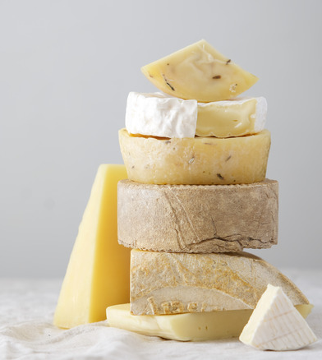
The World Cheese Awards
- Final Interactive Dashboard
Group 4:
Kasha Muzila
Karl Eirich

Slide 2
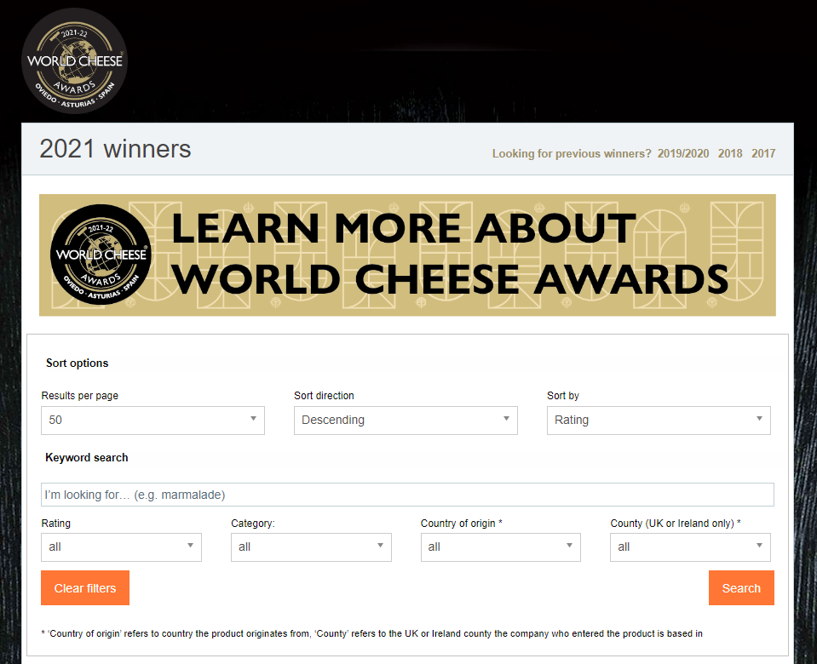
Overview
Visualize results from the 2021 World Cheese Awards
Website includes 1,700 entries:
Companies
Cheese names
Rank
Product name
Category
Country
County
https://worldcheeseawards.com/wca-results
Notes:
Karl: Explain background on dataset, where we got the dataset and what’s in it, why we are analyzing it. Most of this info can be found on the proposal https://docs.google.com/document/d/1mbfLlisNXu9waht0G0rzid7QmGHrB26aHP3tshdGmhA/edit?usp=sharing

Slide 3
Suggestions and Bugs from Usability Study
Suggestions
Bugs
Better color scheme for geographical map and dashboard
Include About Us section
Include touch point over cheese icon for original data source
Dropdown options should be chronological and selectable options should be towards the top of dropdown
Include pie graph
Fix filter option functionality
Dropdown options were not updating correctly,
Geographical map does not have filter functionality
Graphs don’t update properly

Slide 4
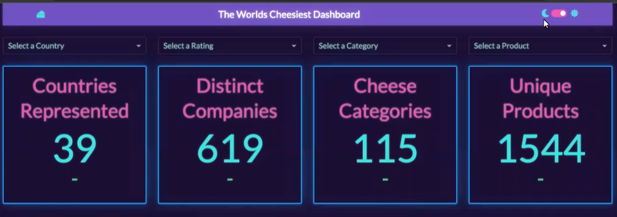

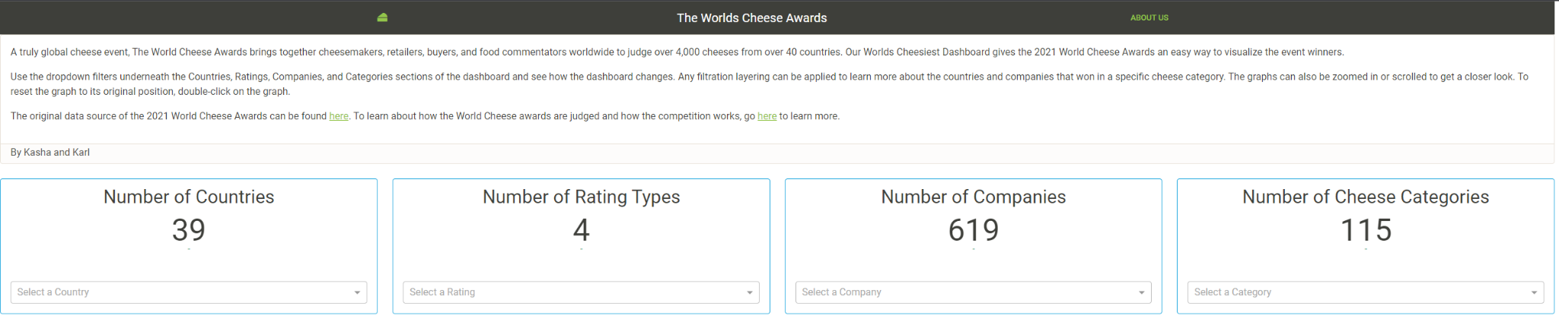
Suggestions and Bugs from Usability Study
Before:
After:

Slide 5
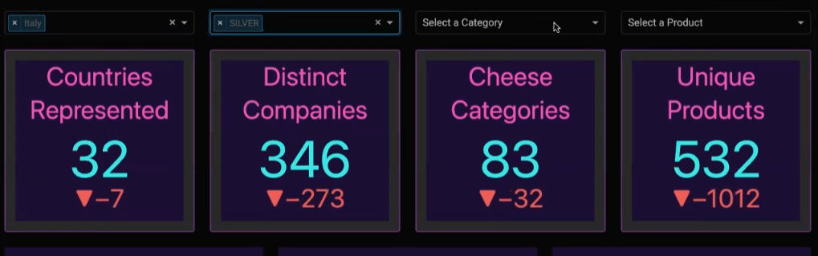
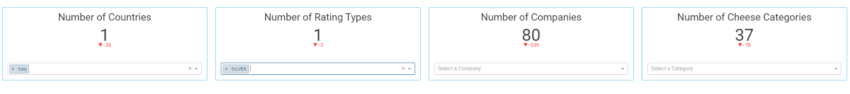
Suggestions and Bugs from Usability Study
Before:
After:

Slide 6
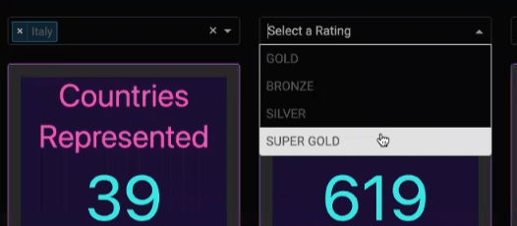
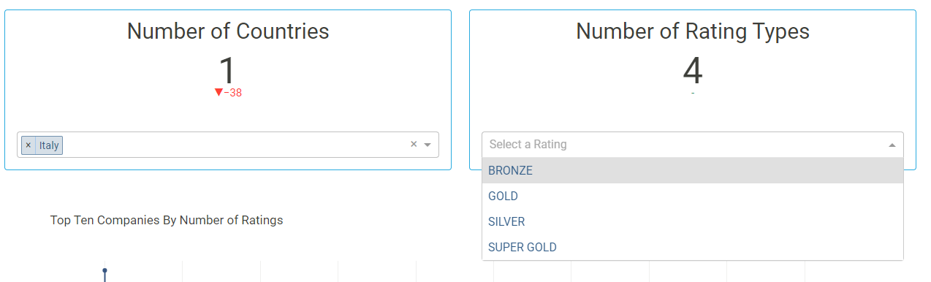
Suggestions and Bugs from Usability Study
Before:
After:

Slide 7
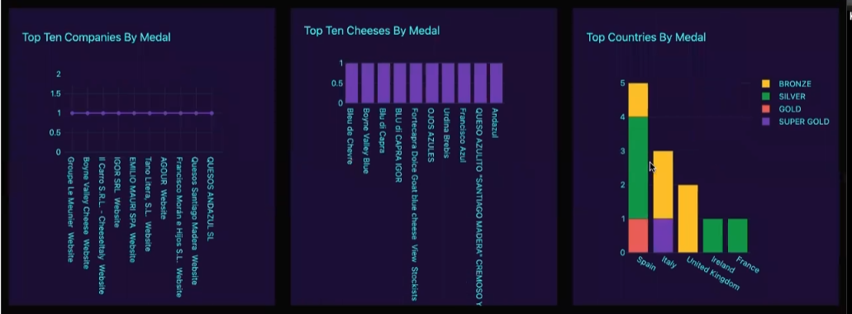
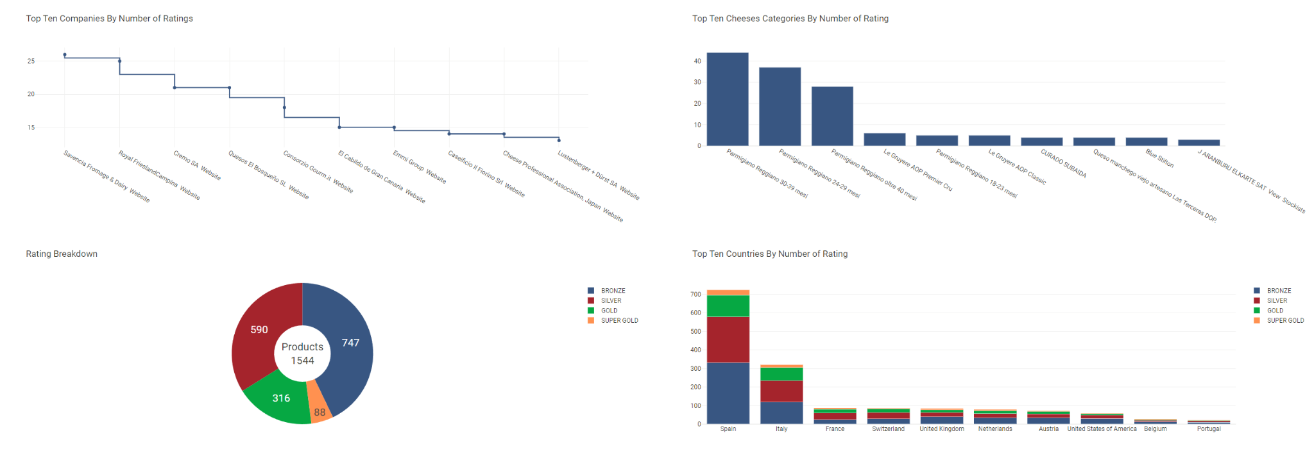
Suggestions and Bugs from Usability Study
Before:
After:

Slide 8
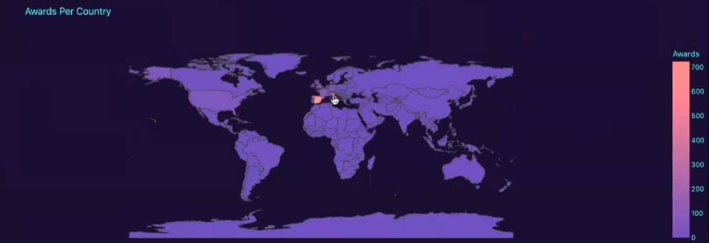
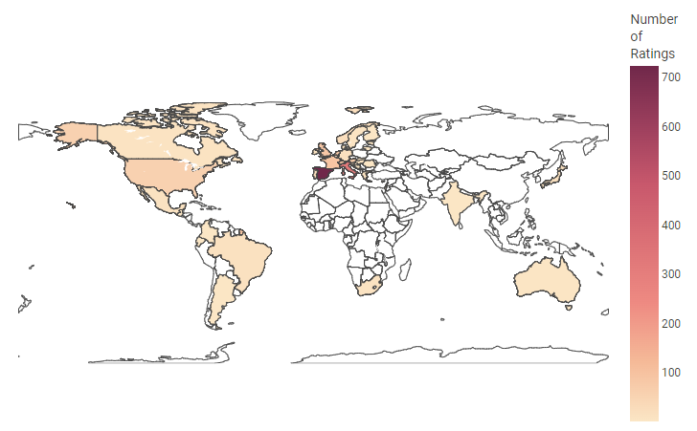
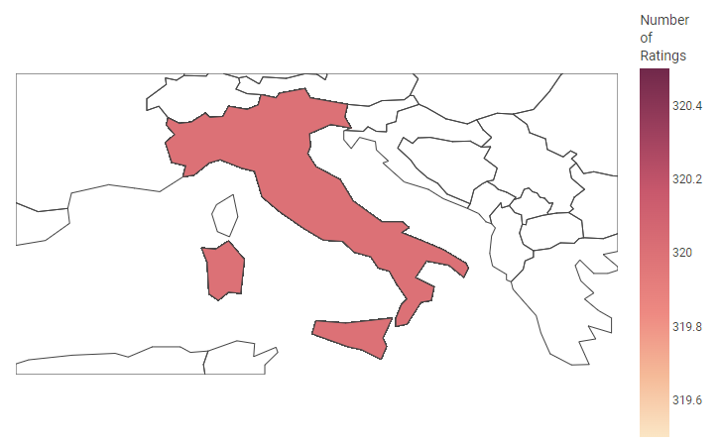
Suggestions and Bugs from Usability Study
Before:
After:

Slide 9
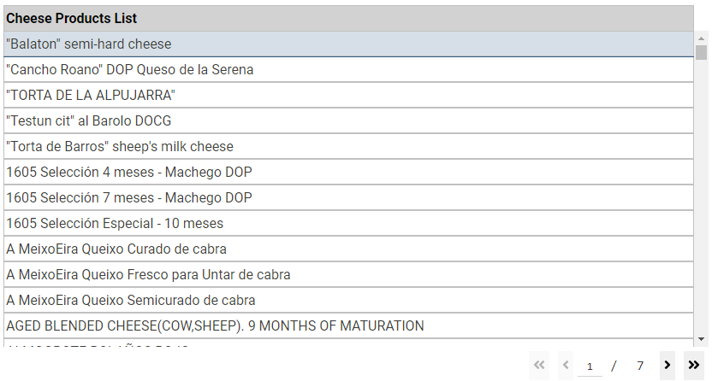
New to the Dashboard

Slide 10
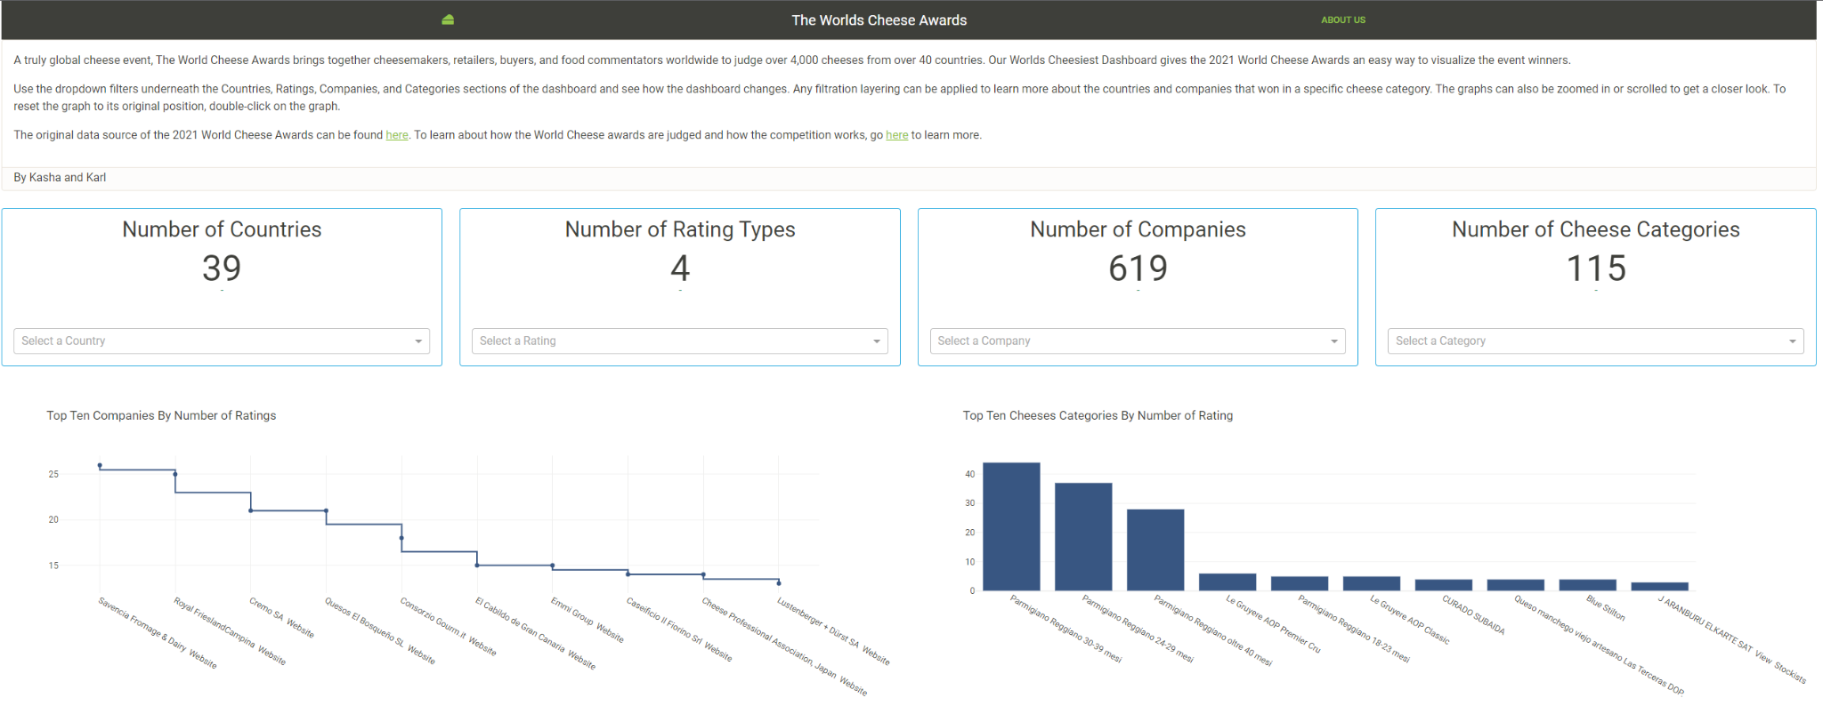
The World Cheesiest Dashboard Demo
https://apps-fall22.ischool.berkeley.edu/~keirich/w209/dashapp/
Notes:
Do demo and talk about what language you used and how you built it
Show the following and how it updates the dashboard graphs:
Read about us section
Show one filter option per dropdown
Show two different filter options applied at same time
Show three different filter options applied at same time
Show 4 different filter options at same time
Start with default and pick two countries
Then add a different filter option
Show touch points on graphs
Show zooming on graphs, especially on geo map
Show scrolling on graphs, and double click graph to go back to default

Slide 11
Future Steps
Hyperlinking cheese products on appropriate graphs
Including more cheese graphics for aesthetics
Upgrade the cheese products list to a pivot table
Notes:
Talk about what we didn’t get to have time to do
Get hyperlinks on the cheese products list so users on the dashboard can purchase the cheese products they learned about
Include more cheese graphics on the dashboard to make it more aesthetic and fun
Upgrade the cheese products list to a pivot table to gain more insight on how the other graphs tie in with each other.

Slide 12
Thank You

